Slide 1

DRUG DEVELOPMENT LIFECYCLE
Exploring the adverse effects of drugs eco-system for
patient centered care.
Sumanth Hagalavadi Gopalakrishna Sravya Yella
Neelambari Verma
Explorers

Slide 2

Description
The project is a Drug Development life cycle ecosystem that work on the creation of drugs and adverse effects of drugs on the patient's. Also action taken and penalties that have been charged by the administration i.e. FDA (Food and Drug Administration) on drug companies to solve issues. The drug is approved/denied based on the adverse effects on the individual cases in history.
Explorers

Slide 3

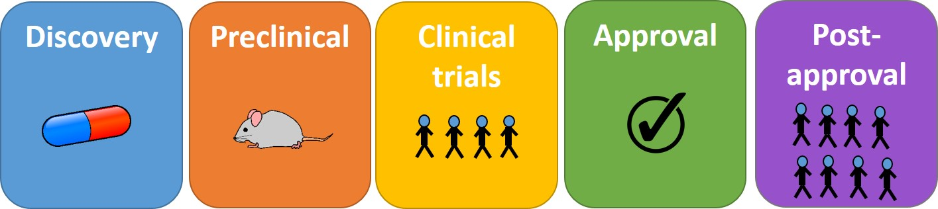
Life Cycle
f a Drug
Explorers

Slide 4

Problem Statement
Taking the drug based on the disease and adverse effect caused by the drug.
Adverse effects of a drug on differents kinds of patient’s.
Approving the request from FDA and sending the score of the Lab report via Email.
Drug creation and side effects on people.
Safety Procedure implementation of drugs which has been manufactured.
Explorers

Slide 5


Solution to Denial of drugs
Insurance organisation involves when a drug is denied by FDA and pays the penalty for the user who are part of clinical trials. Also, the drug is banned further in the market.

Slide 6


Special Features
Adding IoT feature of email to send request to Authority from PreClinical Trial and Post Clinical Trial report via Email.
Implementing Naranjo Algorithm to create the Lab report which is defined by FDA.
Adding Multithreading feature when there is more processing in the application.
Interpretation of Adverse event scores are analysed and based on the analysis, reports are created which is sent via emails.
Showing Interpretation scores on progress bar, pie charts, and loading scale.
Explorers

Slide 7
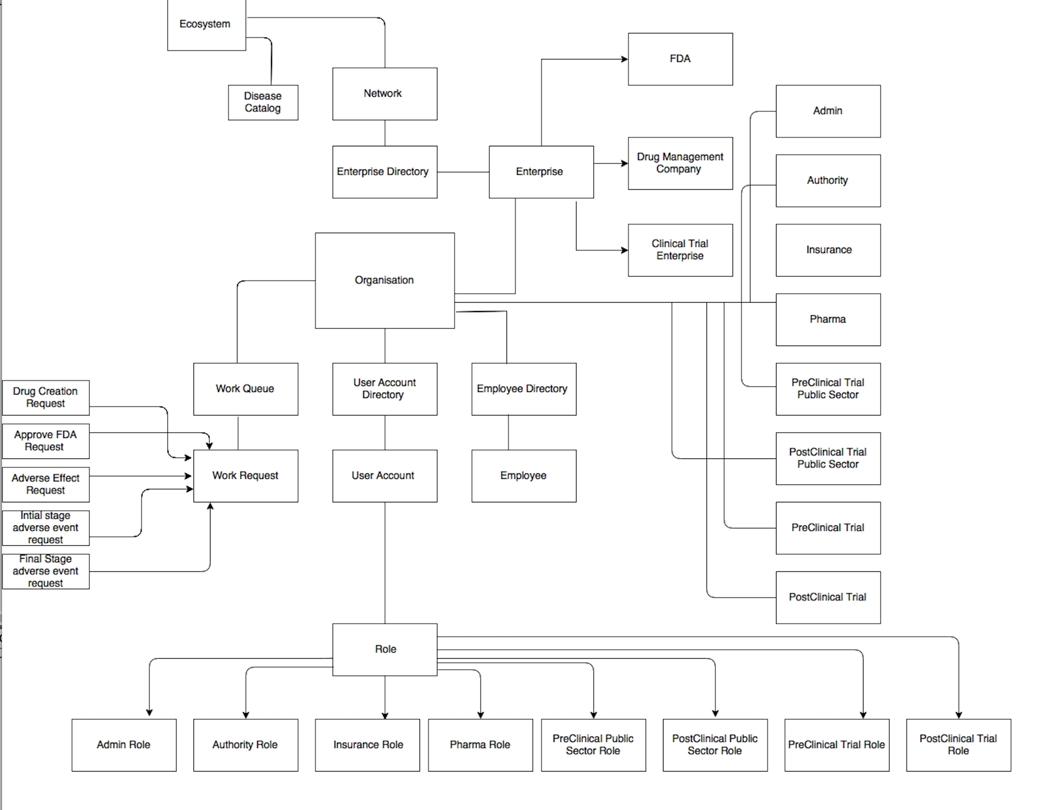
Object Model
Explorers

Slide 8



Key roles
Admin Role
Authority Role
Insurance Role
Pharma Role
PreClinical trial Role
PostClinical trial Role
PreClinical Public Sector Role
PostClinial Public Sector Role
System Admin Role
Explorers

Slide 9
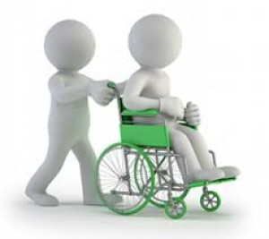

Use Cases
Involving Patient for test cases.
Sending request from Pharma to FDA.
Approving request from FDA and sending request to Pre- Clinical and Post- Clinical Trial Organization.
Clinical trial will process the request and do calculation according to Naranjo algorithm.
This score which has been calculated will be sent via Email along with report and request to FDA.
FDA can view the completed request score report.
Based on the interpretation score, FDA decides the drug status.
Insurance organization will take money from pharma company and distributes to people who has undergone clinical trials.
Explorers

Slide 10
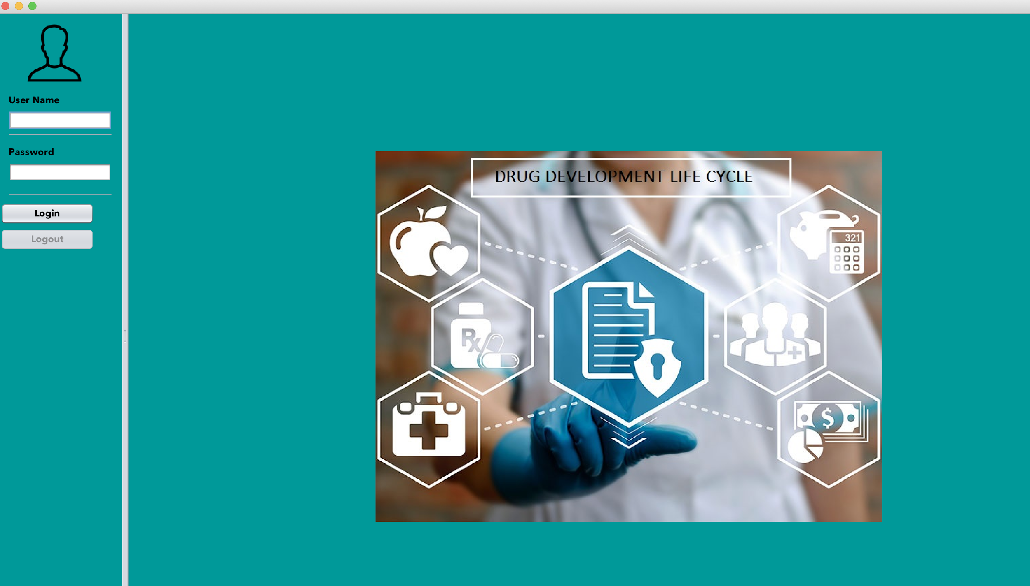
Screenshots of the Project
Login page:
Explorers

Slide 11
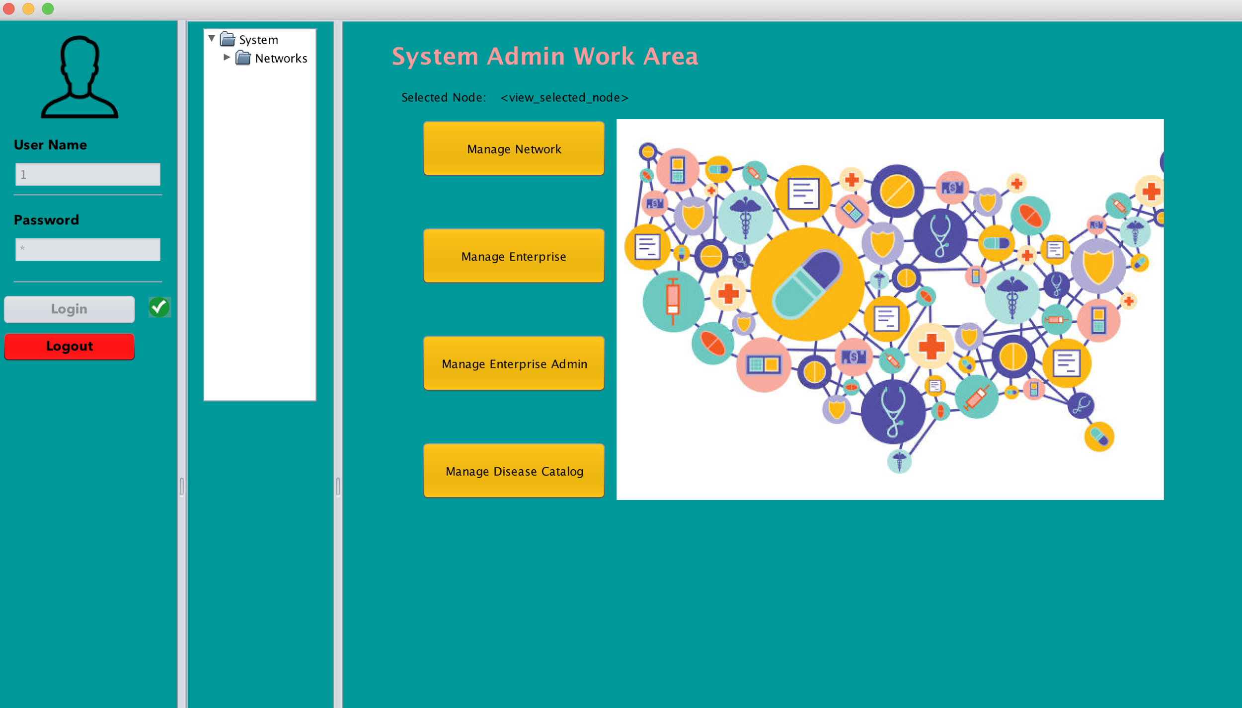
After logging in

Slide 12
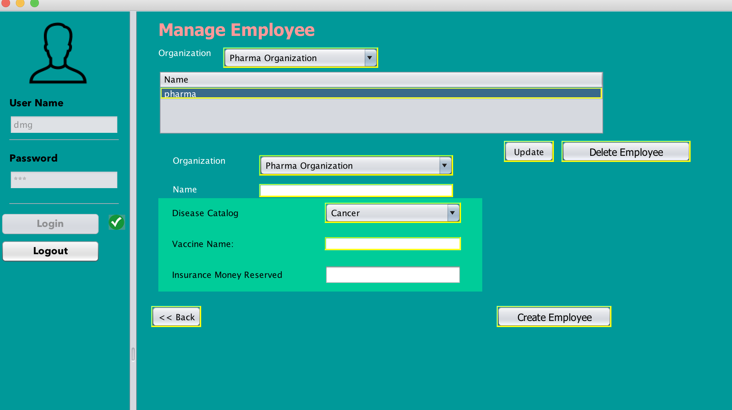
Drug Management Organisation

Slide 13
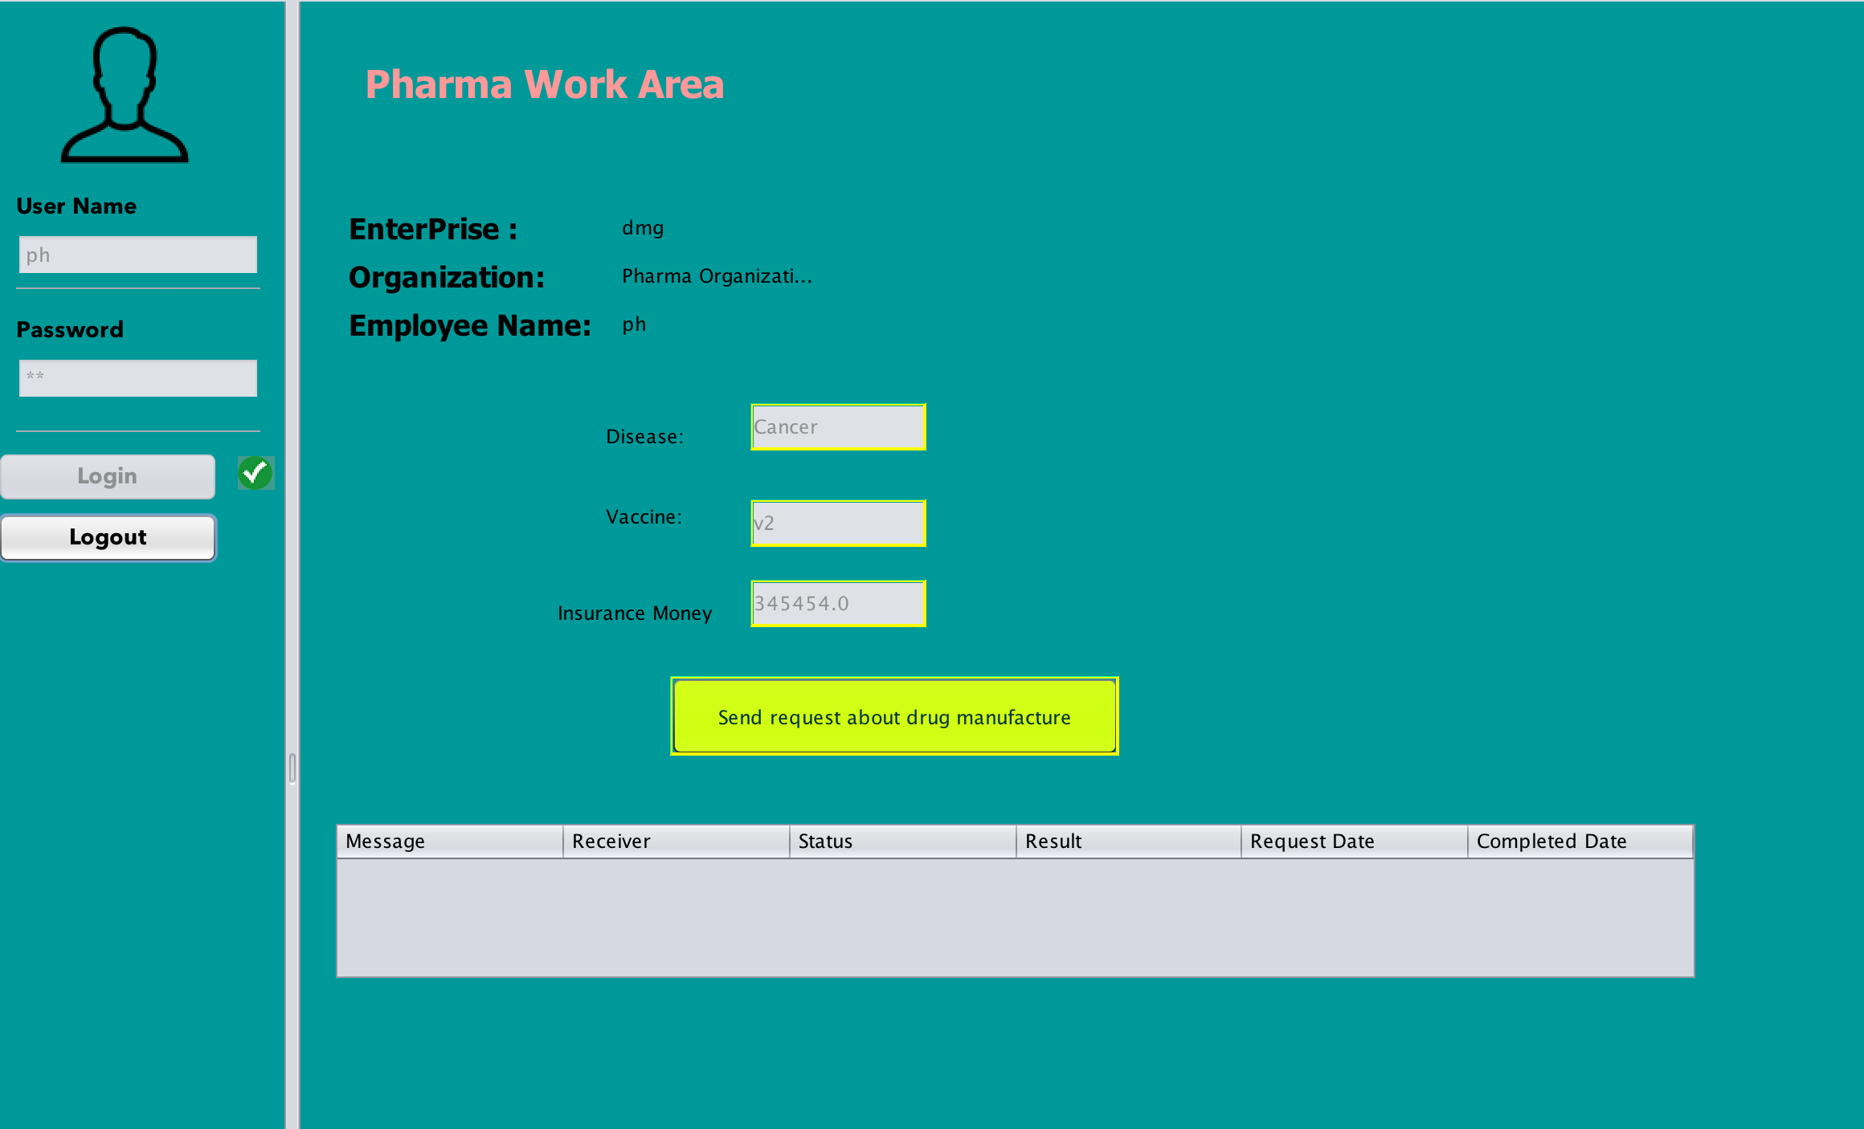
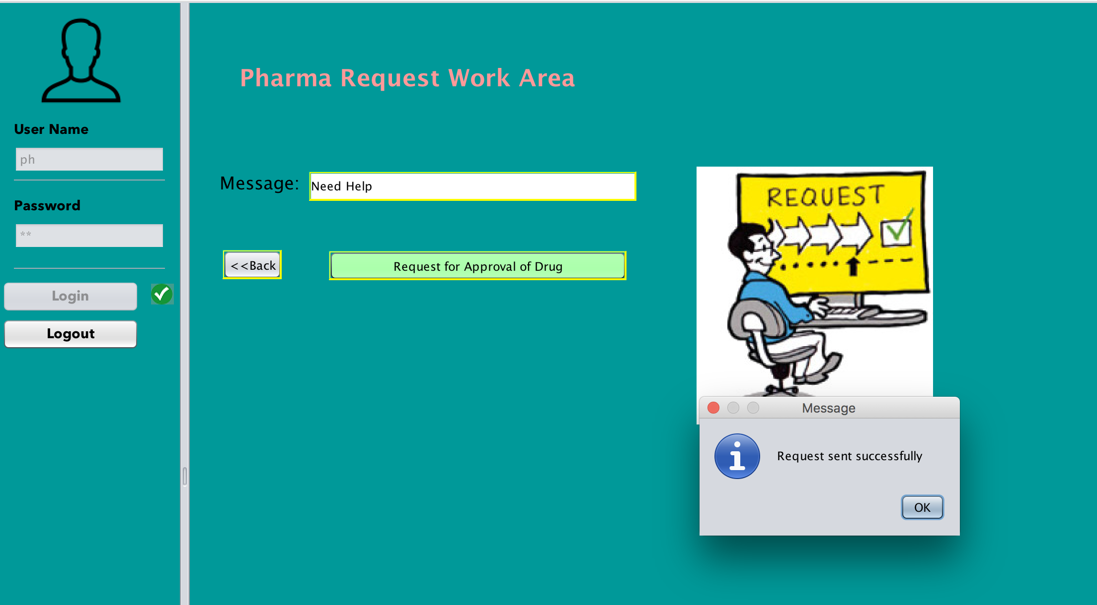
Pharma Request

Slide 14
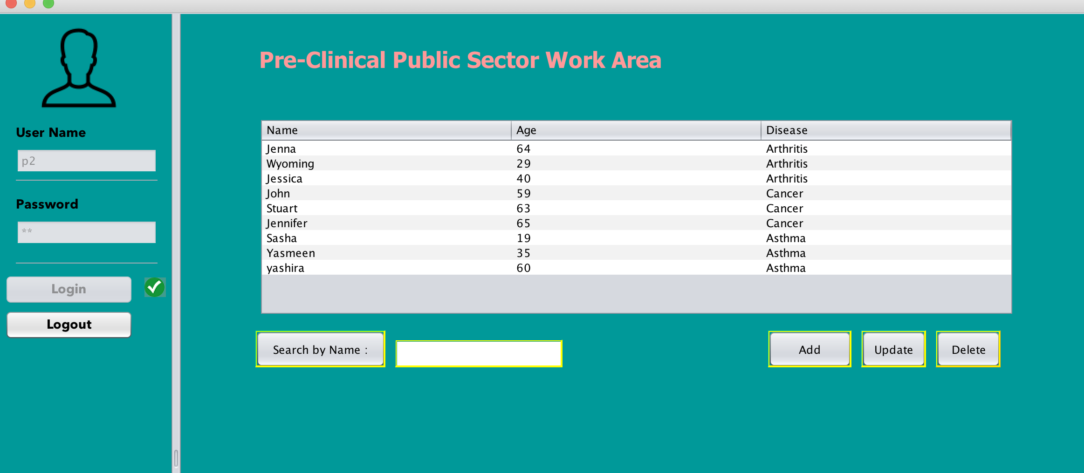
Pre Clinical Public Sector Work Area

Slide 15
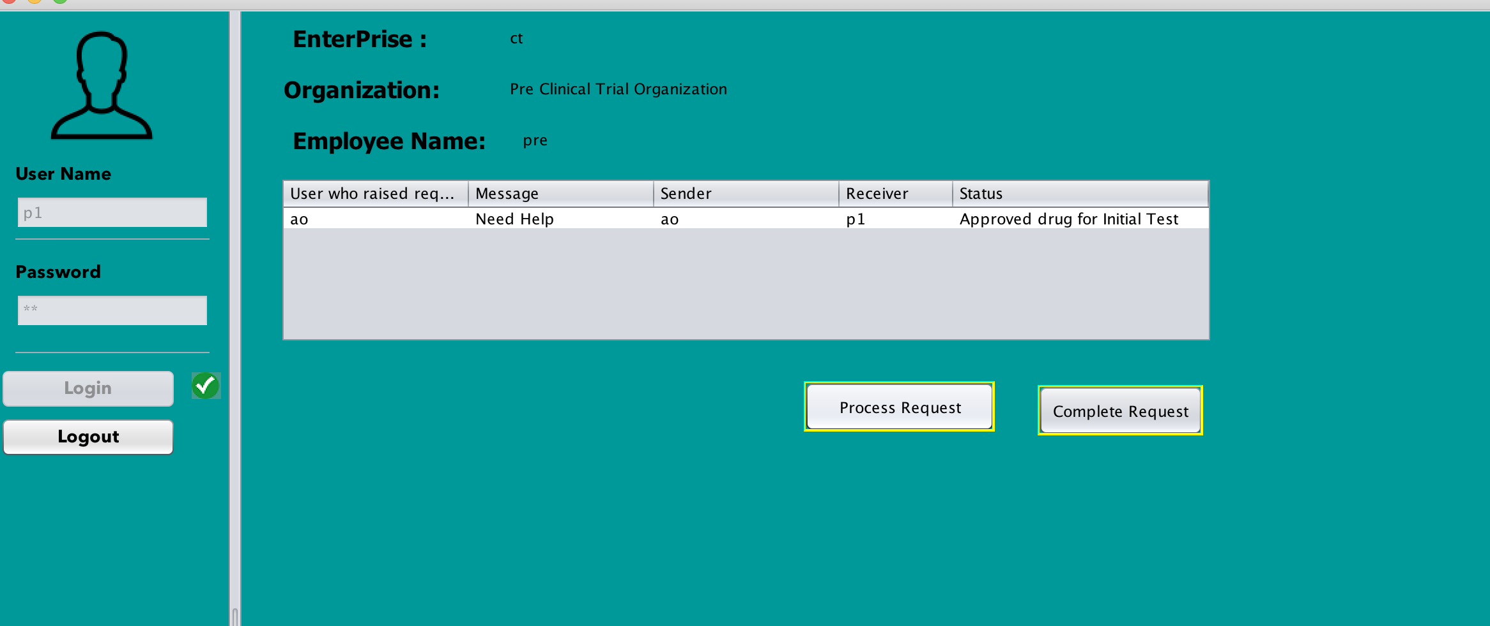
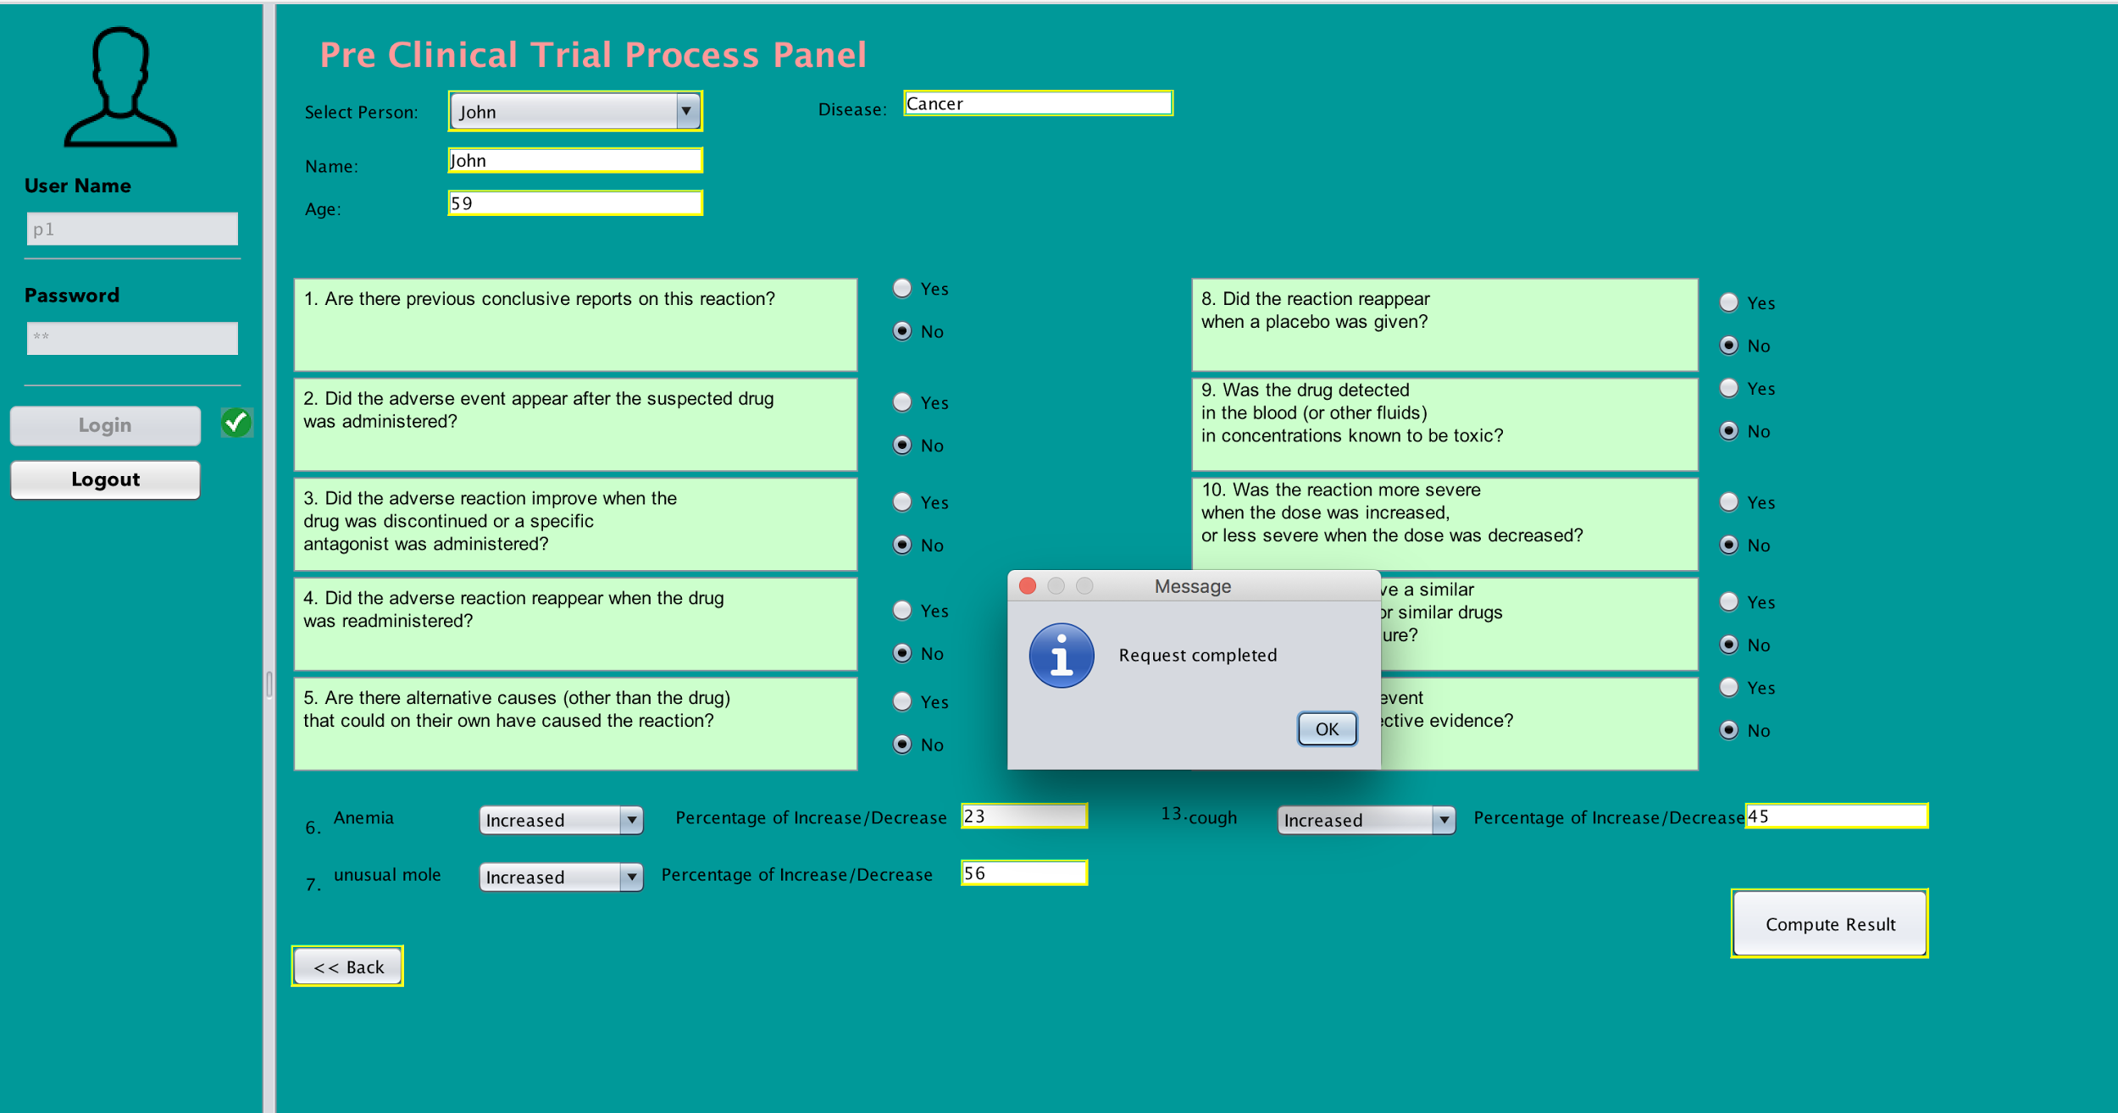
Pre Clinical Trial Organization

Slide 16
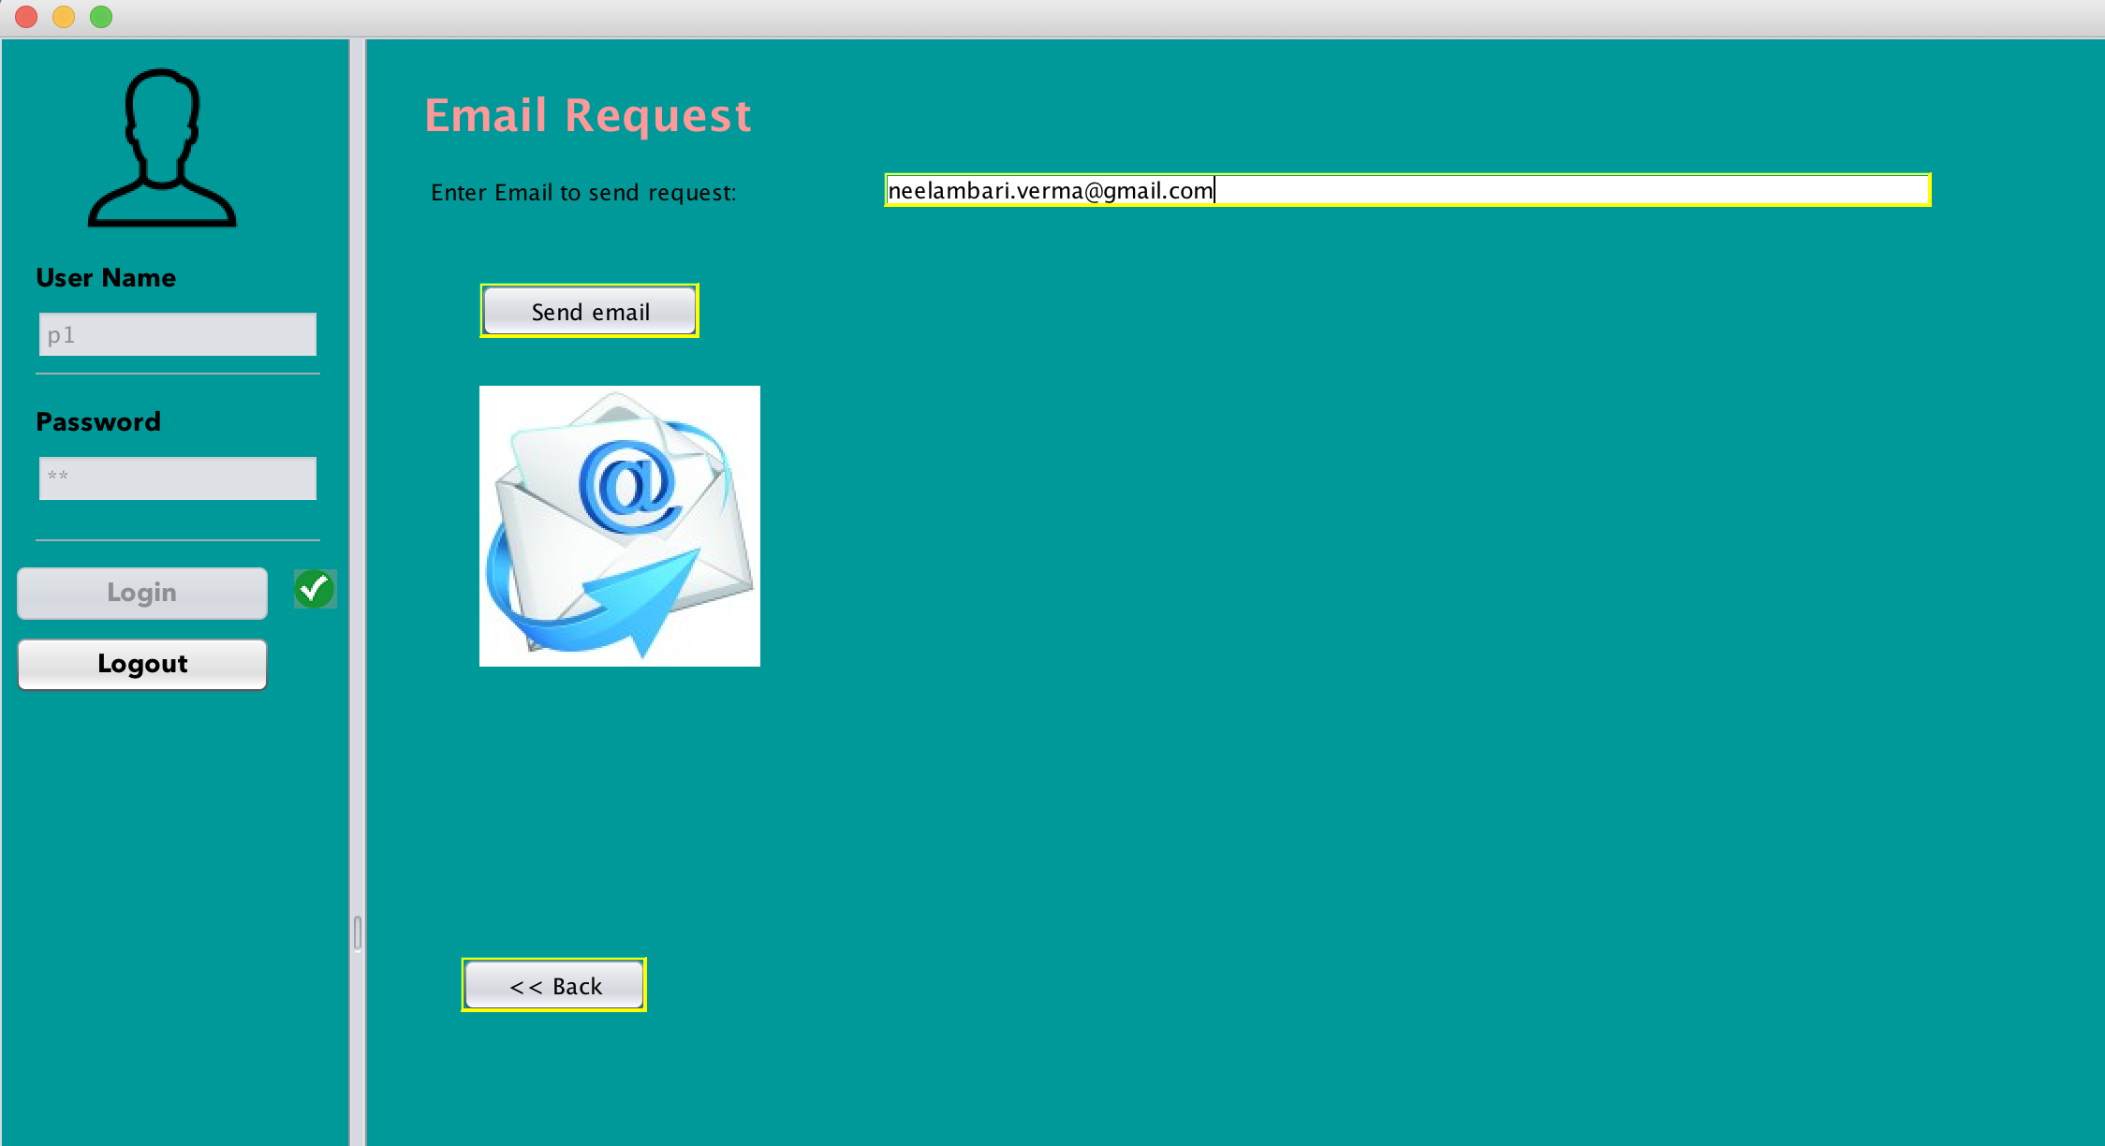
Email Request

Slide 17
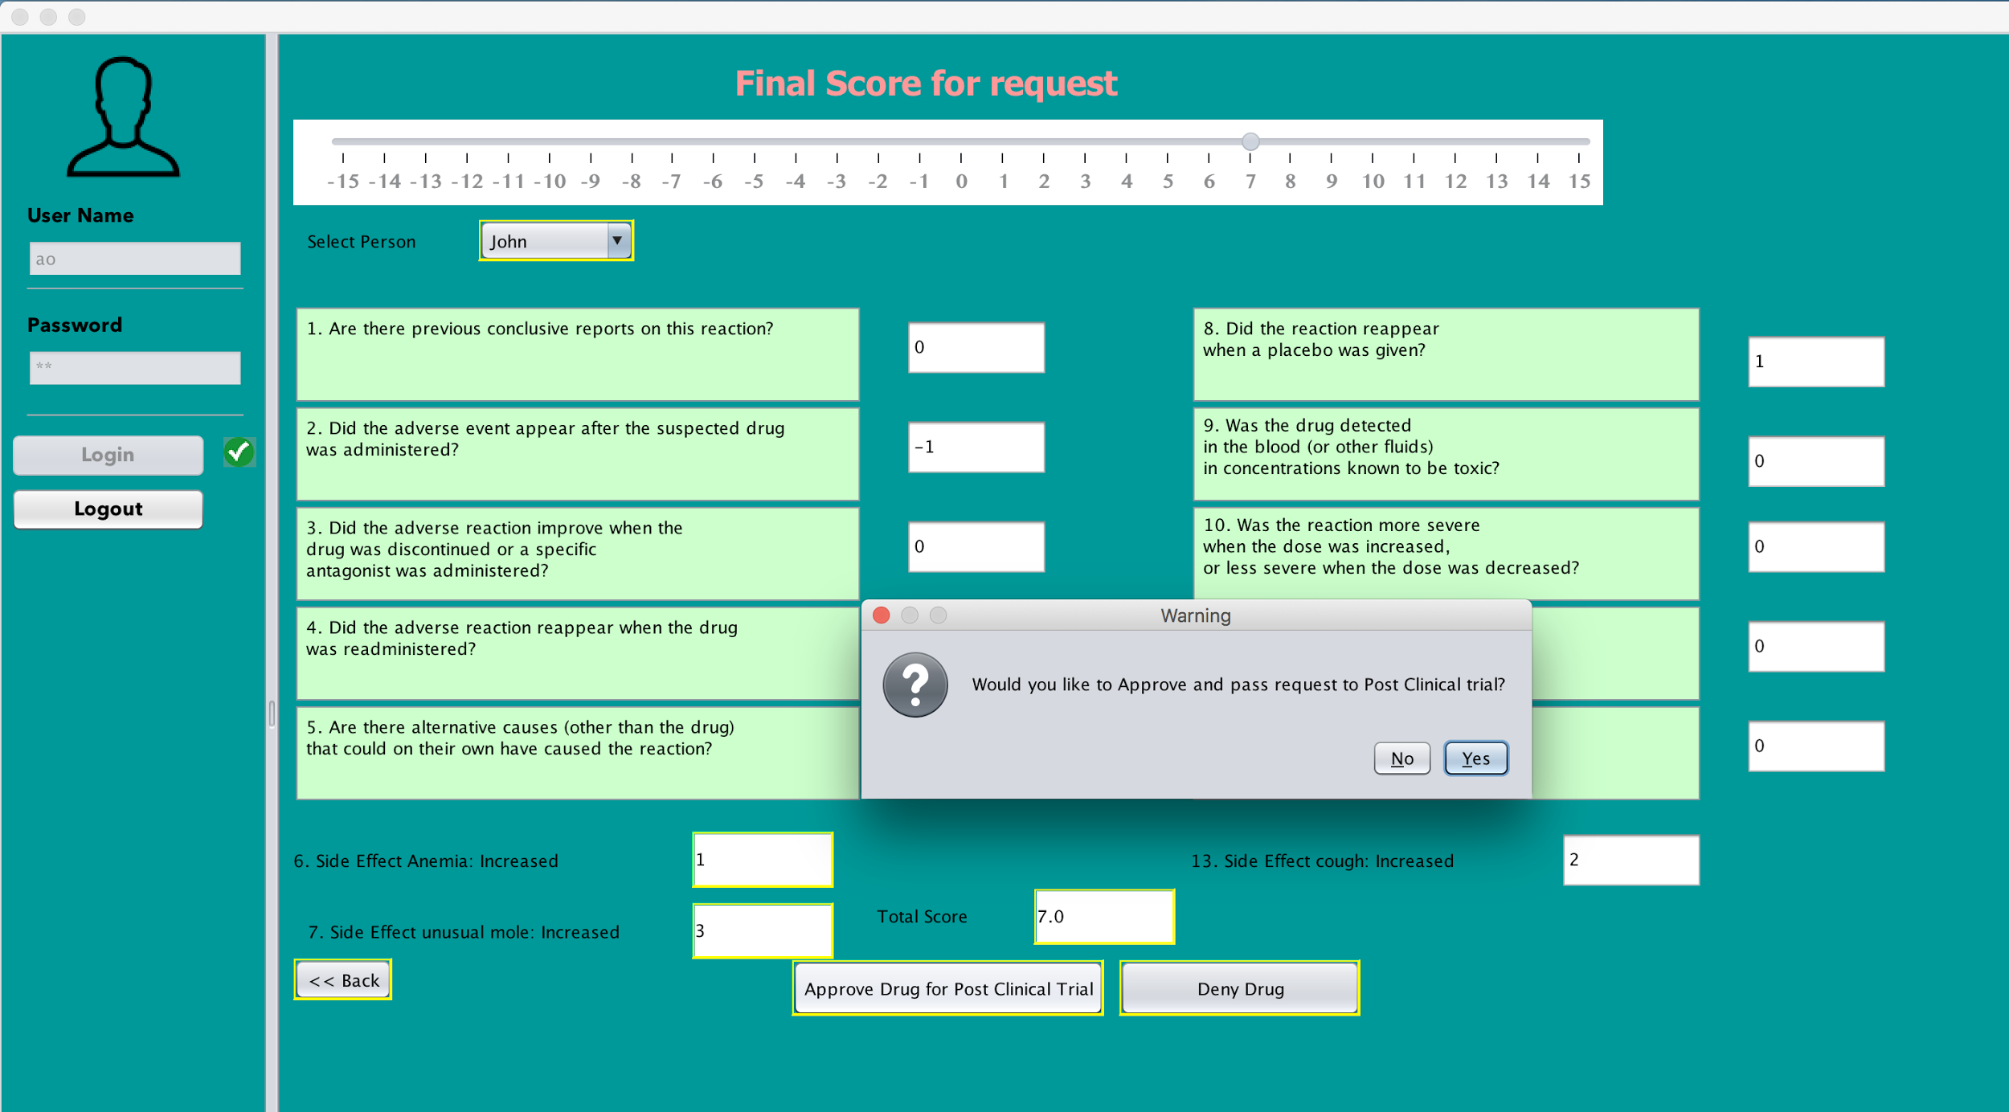
Final Score Using Naranjo Algorithm
Drug is approved or banned based on the Adverse effect Score

Slide 18
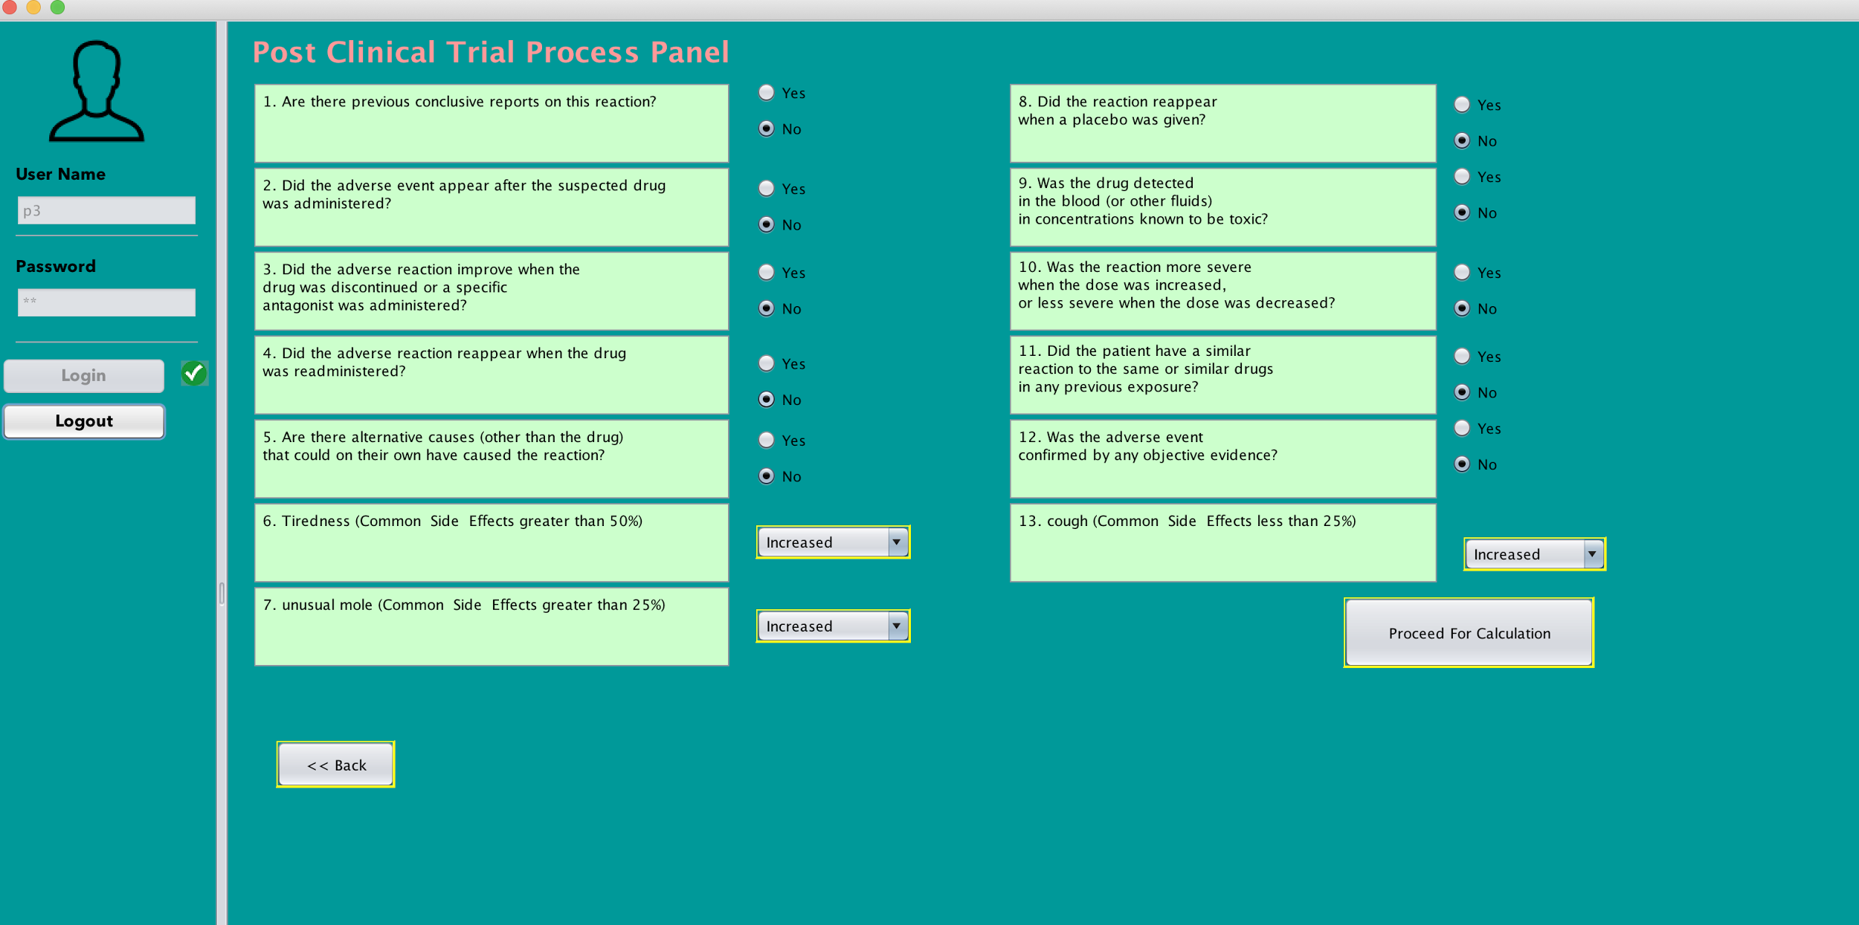
Post Clinical Trial Process Panel

Slide 19
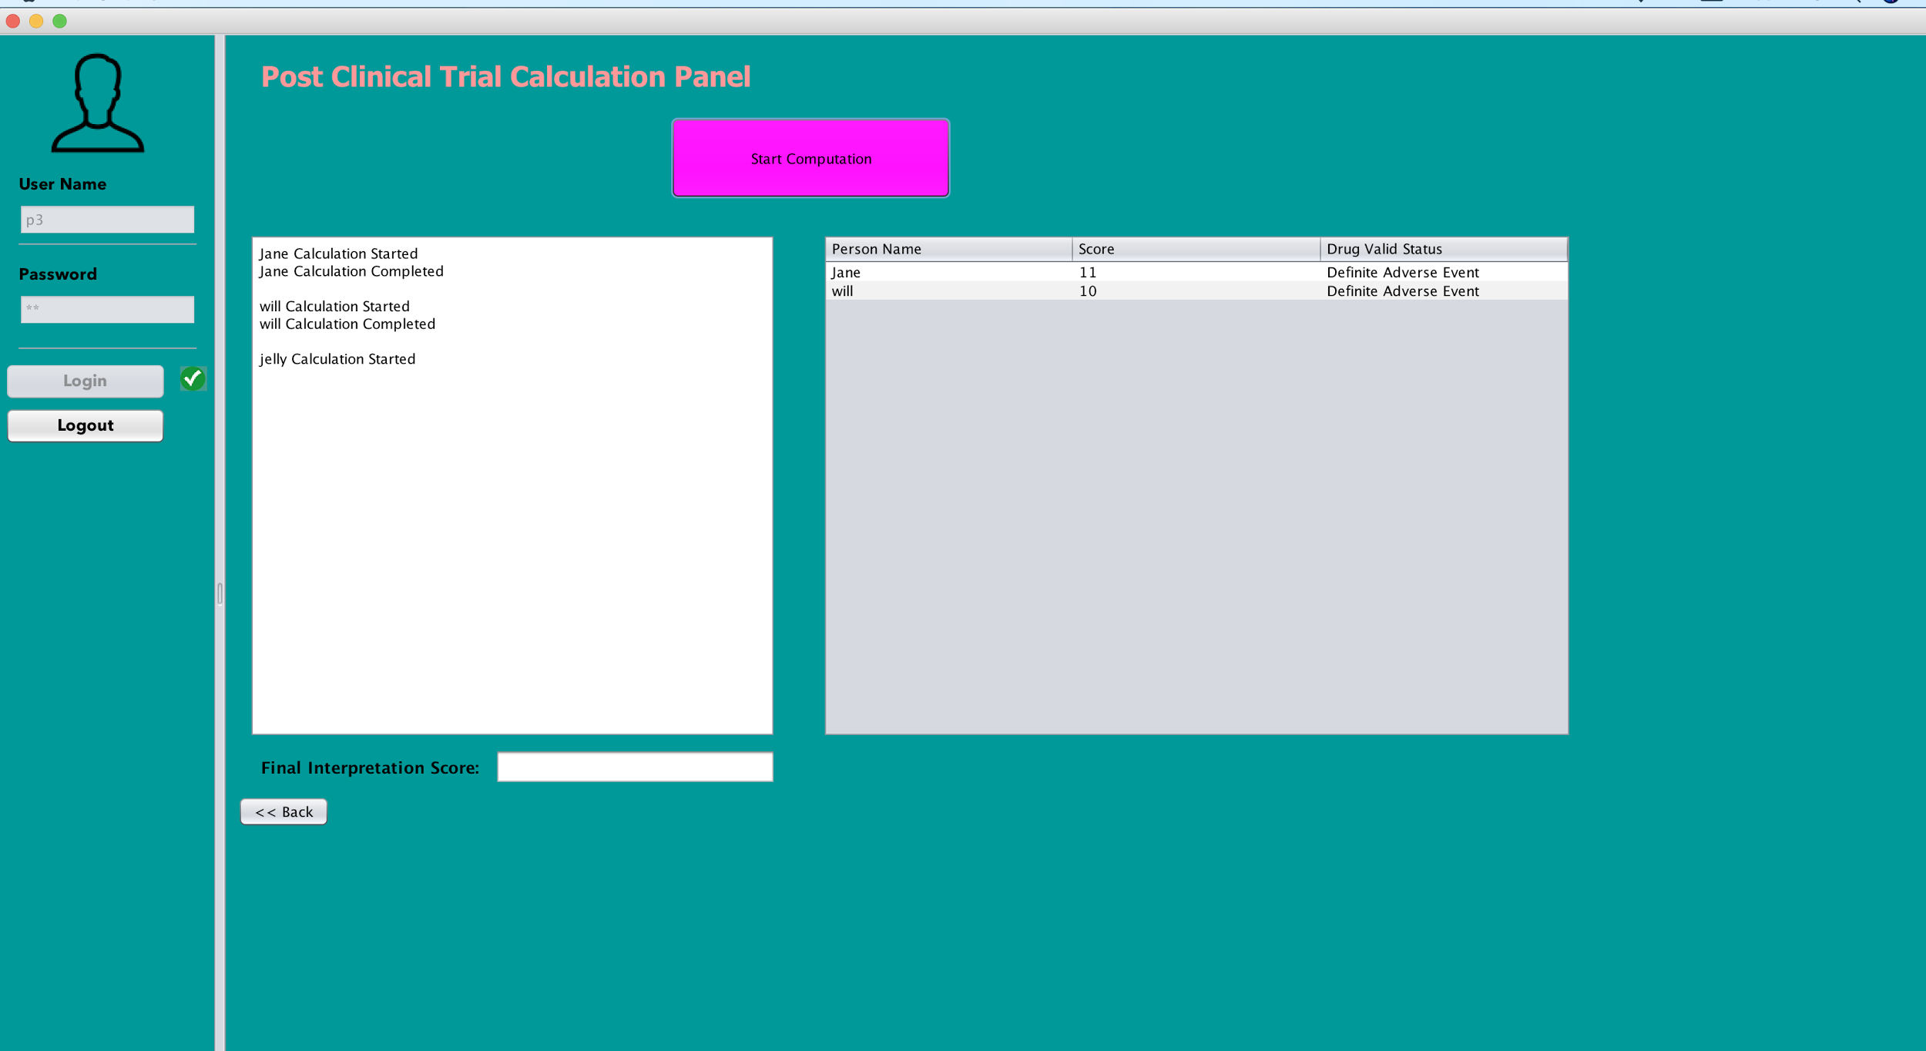
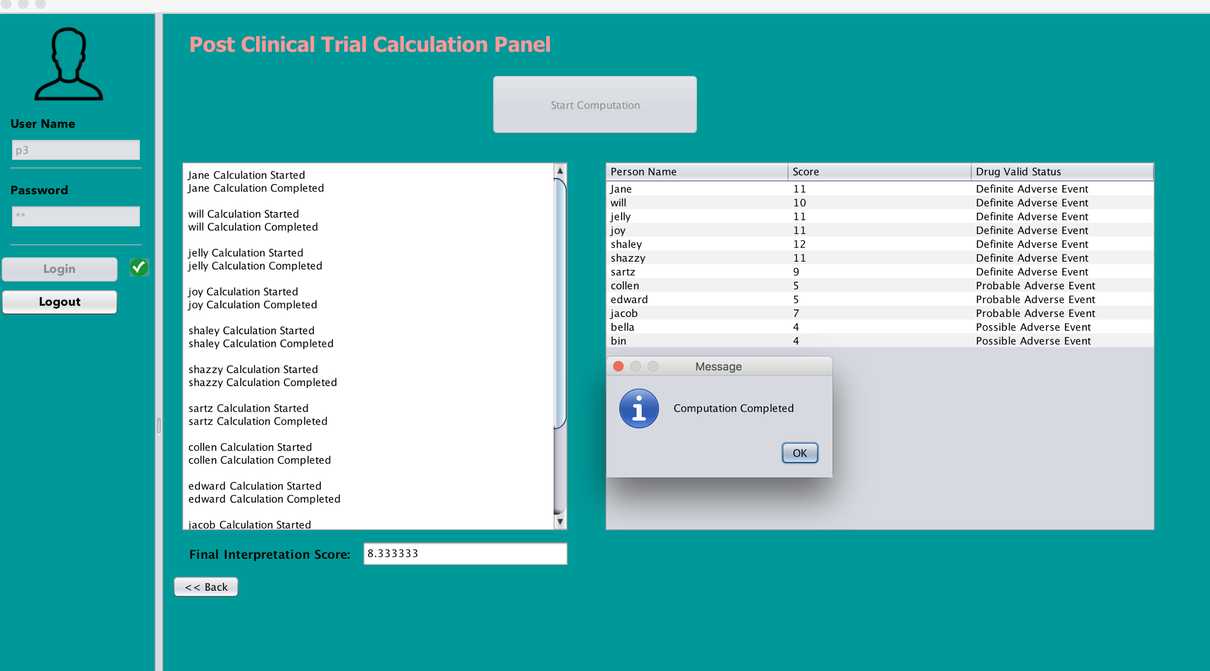
Post Clinical Trial Calculation Panel
Calculation of adverse effects of drug is performed based on multi-threading feature.

Slide 20
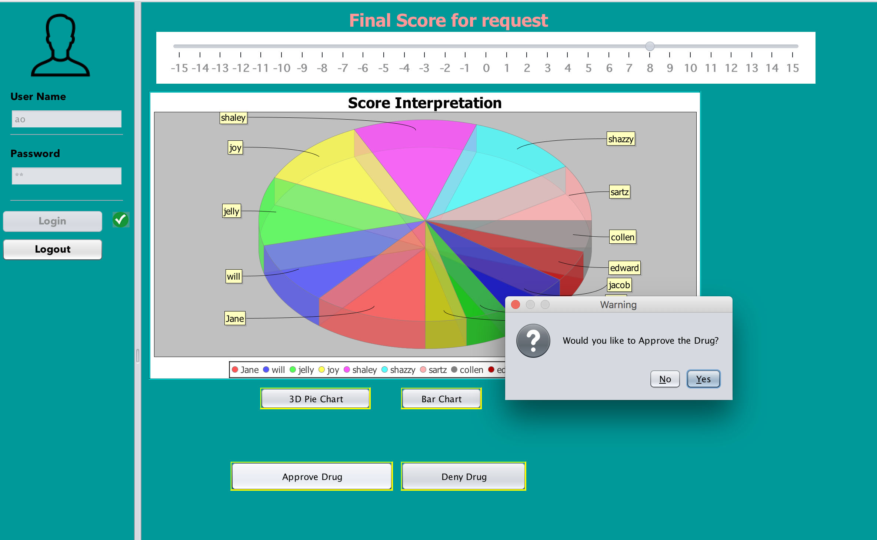
Final Score in Pie and Bar Chart

Slide 21
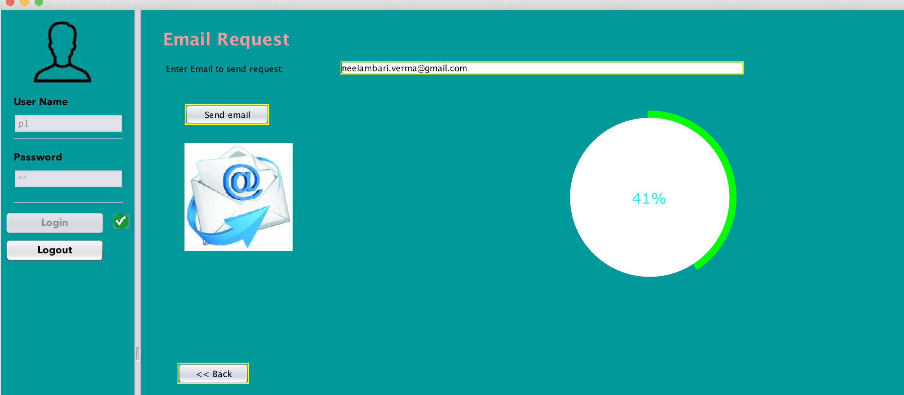
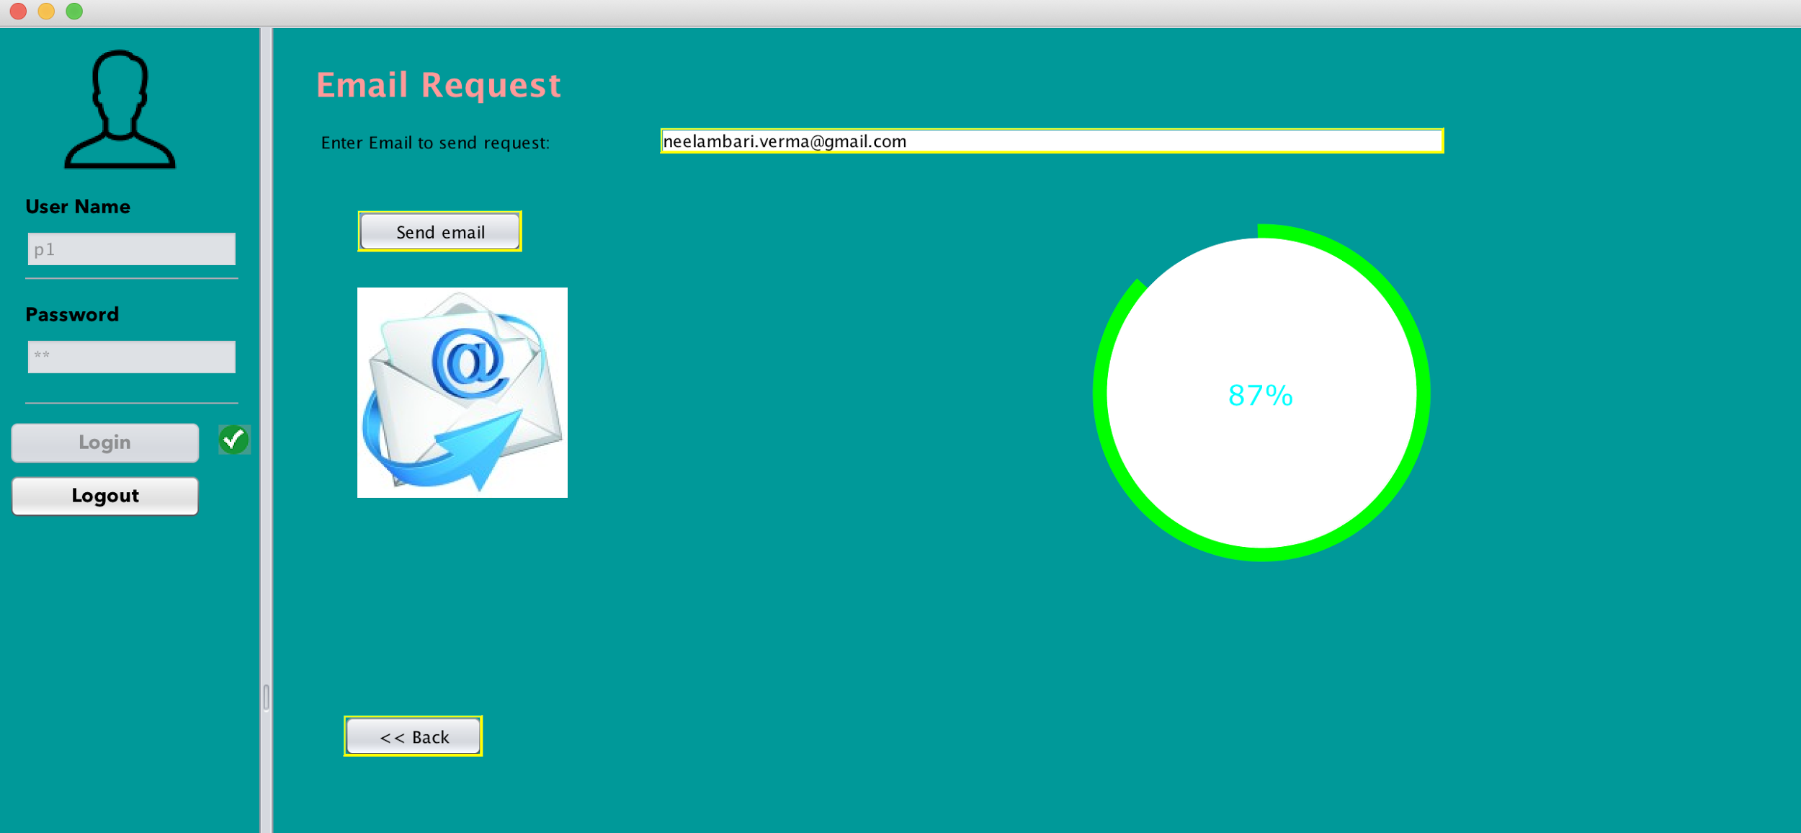
Email Request
Email Request with loading feature based on threads.

Slide 22
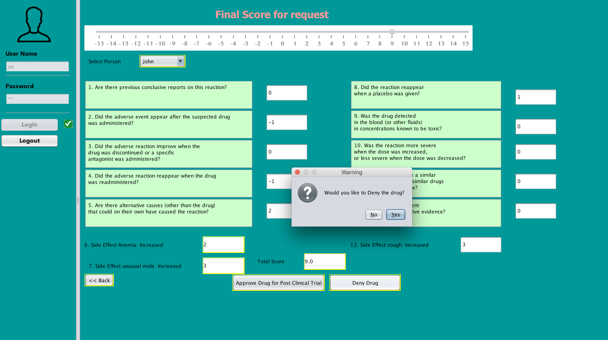
Penalty for banned drugs

Slide 23
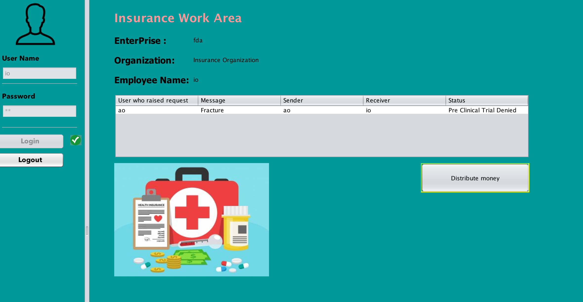
Insurance Organization Work Area
Explorers

Slide 24
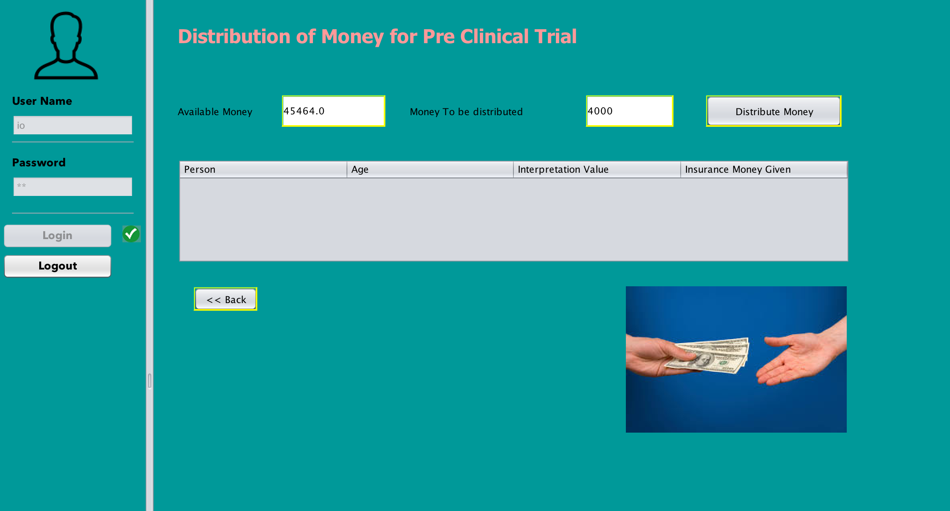
Money Distributed to the user
Explorers

Slide 25

Naranjo Algorithm
Joint Pain increased
Pre Clinical Trial
Naranjo Algorithm will process based on the question answered by Pre Clinical Trial Organization.
Along with question, major side effects will be considered and based the percentage of increase or decrease of these side effects, scores will be predicted.
Final score will be the average of the interpretation scores on all person in the clinical trial
Post Clinical Trial
Large number of people will be considered in the Post clinical trial organization and same Naranjo Algorithm questions will be considered for calculation of interpretation scores
Along with the questions, Percentage of common side effects and age of the person will be considered for calculation of side effects.
Naranjo scores of 9 or 10 indicate that an event was "definitely" an Adverse Drug Reaction; scores of 5-8 rate the likelihood as "probable" Adverse Drug Reaction; scores of 1-4 are "possible" Adverse Drug Reaction; and scores of less than 1 are "doubtful. Adverse Drug Reaction".
Explorers

Slide 26
Continued...
For Pre Clinical Trial, Calculation of score based on side effects are as follows:
If the side effect is increased , then accordingly 1,2,3,4 values will be assigned based on percentage and if side effects are reduced, scores of 1,2,3,4 will be assigned in negative values.
For PostClinical Trial, Calculation of score based on Common side effects are as follows:
If the common side effect is increased based on percentage, values ranging from 3 to 12 will be added to the final score and if its decreased, scores will be assigned in negative values.
Explorers

Slide 27
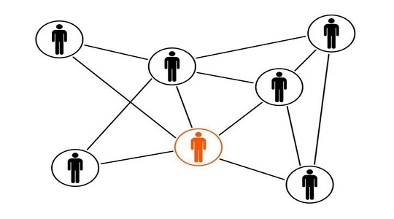
Pharma-FDA-PreClinical-Insurance Social Network
Pharma sends requests for vaccines to FDA for initial approval.
Pre-clinical trial and Post clinical trial have their own Lab reports which is sent for approval.
Approval/Denial based on the score of the adverse effects for that particular drug.
Insurance organisation will provide the penalty if it exceeds the threshold.
Explorers

Slide 28

Explorers

